Slide 1
Ayush Kumar Swarali Utekar Rohit Kalaskar Vishwa Doshi
CAMPUS NETWORK DESIGN
01

Slide 2
Table of Contents
02
Introduction
Modules of The Project Campus Design
Cisco Packet Tracer Design Network Equipment Selection Inference
Conclusion References

Slide 3
Introduction
03
This College network Architecture is about designing a topology of a network that is LAN for a College in which various computers of different departments are set up so that they can interact and communicate with each other by interchanging data

Slide 4
MODULES OF
THE
Campus Design
Cisco Packet Tracer Design
Description Project
Network Equipment Selection
Network Device Configuration
04
PROJECT

Slide 5
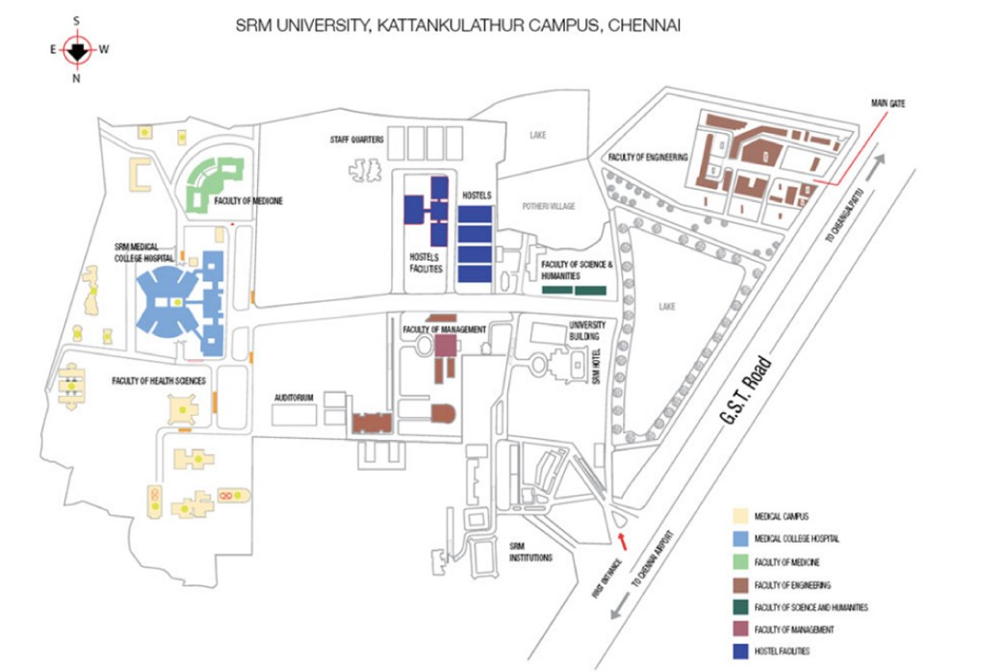
CAMPUS DESIGN
05

Slide 6
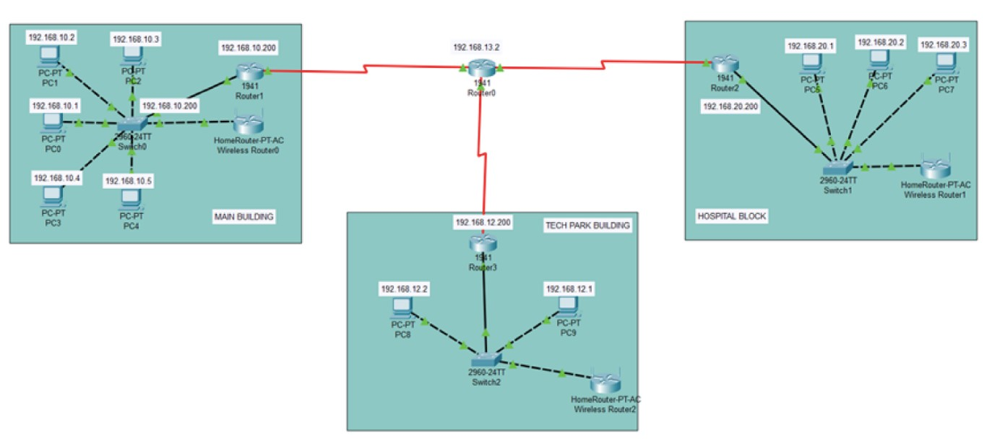
CISCO PACKET TRACER DESIGN
06

Slide 7
Description
07
The Campus network system is divided into Core Layer,Convergence Layer,and Access Layer

Slide 8
NETWORK EQUIPMENT SELECTION
Switches
Routers
Serial DCE Cables
Copper DCE Cables
PC
08

Slide 9
Inference
09
This project has proven that a standard network system can be designed with great Efficiency. The Security of this network turned out to be very strong.

Slide 10
CONCLUSION
With the advent of the internet age,the impactof our education is unprecedented,and it also provides a rapid leap for education oppurtinities,education should be oriented towards modernization,facing the world ,for facing the future,we must first face the network
10

